Slide 1

﷽
In the name of Allah, The Most Gracious and The Most Merciful

Slide 2
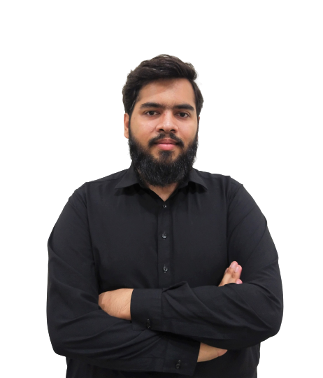
Zaeem Muhammad Yaseen 20F-0329
BSCS (7th Semester)

Slide 3
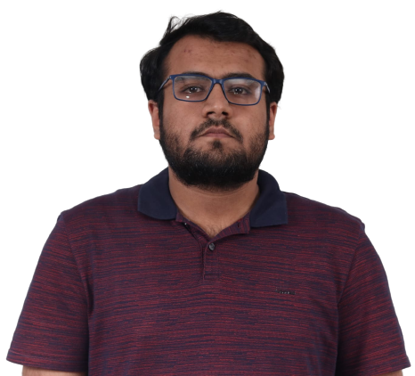
Hamza Sajjad 20F-0297
BSCS (7th Semester)

Slide 4
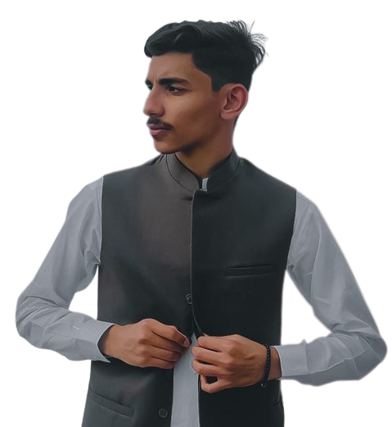
Muhammad Umar Kamran 20F-1047
BSCS (7th Semester)

Slide 5






TABLE OF CONTENTS
Problem Statement
Tools & Technologies
Motivation
High System Design
Features

Slide 6



Problem Statement
Existing education system falls short in accommodating diverse needs.
Some individuals struggle to grasp concepts in traditional classrooms.
Limited access to quality education is a unfortunate reality for many.

Slide 7
Motivation
Provide personalized learning experience for all users.
Making learning fun and engaging.
Make learning accessible to all users including those with disorders.
Improve student learning outcome.
Unique learning styles.
Interactive experience.

Slide 8
Features
Sign Up & Sign In.
Recommend Related Topics.
Topic search.
Interactive learning.
Image selection.
Personalized learning.
Language selection.
Accessibility.
Accent selection
Help portal.

Slide 9




Tools and Technologies

